Slide 1
20. Graph Traversal: BFS and DFS
ECE 309
Dr. James Tuck

Slide 2
Objectives
Describe what it means to traverse a graph.
Identify two common graph traversals: breadth-first and depth-first search.
Describe how breadth-first search and depth-first search traverse a graph.
Implement breadth-first search and depth-first search in C++.

Slide 3
Traversing a graph
Traversal allows us to discover a variety of properties about a graph:
The nodes it contains
How the nodes are connected: what’s close, what’s far
Paths between nodes
Visit each node once
Traversal forms the basis for many interesting graph algorithms.

Slide 4
Traversing a graph
Two key algorithms for traversing a graph:
Breadth-first search
“find the closest node of interest”
Depth-first search
“find a path to a node of interest”

Slide 5
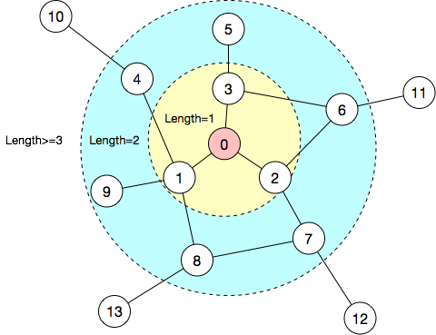
Breadth-first Search (BFS)
From a starting node, visit other nodes in their order of path length away from the start node.
Start at node 0
Next all the yellow nodes
Next all the blue nodes

Slide 6
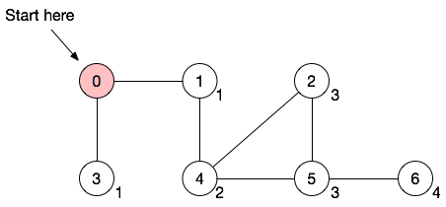
Example of BFS
Consider this graph:
Start at 0

Slide 7
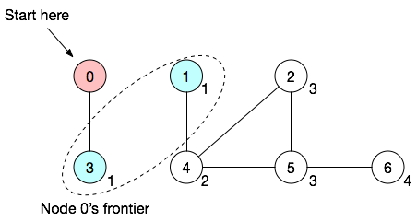
Example of BFS
Consider this graph:
Start at 0
Visit node 0’s frontier of adjacent nodes

Slide 8
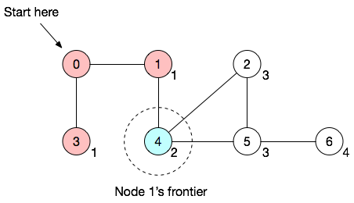
Example of BFS
Consider this graph:
Start at 0
Visit node 0’s frontier of adjacent nodes
Visit node 1’s frontier of adjacent nodes

Slide 9
Example of BFS
Consider this graph:
Start at 0
Visit node 0’s frontier of adjacent nodes
Visit node 1’s frontier of adjacent nodes

Slide 10
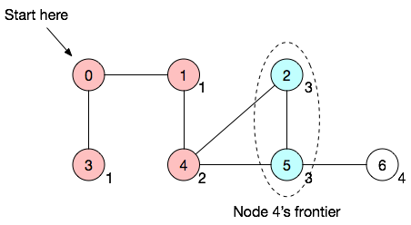
Example of BFS
Consider this graph:
Start at 0
Visit node 0’s frontier of adjacent nodes
Visit node 1’s frontier of adjacent nodes
Visit node 4’s frontier of adjacent nodes

Slide 11
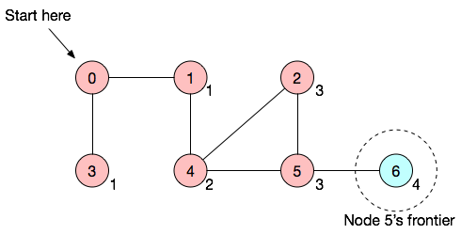
Example of BFS
Consider this graph:
Start at 0
Visit node 0’s frontier of adjacent nodes
Visit node 1’s frontier of adjacent nodes
Visit node 4’s frontier of adjacent nodes
Visit node 5’s frontier of adjacent nodes

Slide 12
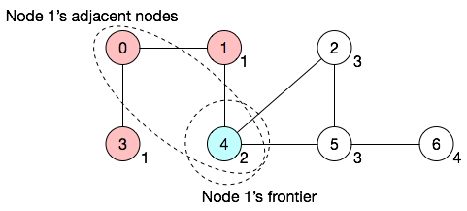
Example of BFS
A node’s frontier should not include nodes already visited in the search.
Node 1’s frontier does not include 0, even though 0 is adjacent

Slide 13
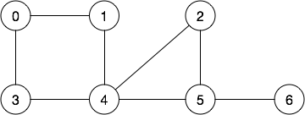
Example
Calculate the BFS order for the following graph twice, once starting at node 6 and once at node 4.

Slide 14
BFS algorithm
BFS(start) {
insert start to discoveredSet;
push start to frontierQueue;
while(frontierQueue not empty) {
n = pop from frontierQueue;
visit(n); // do something in BFS order
for each j, where j is an adjacent node of n {
if (j not in discoveredSet) {
push j to frontierQueue;
insert j to discoveredSet;
}
}
}
}

Slide 15
Example of BFS: starting point
Visit
frontierQueue | 0
discoveredSet | 0

Slide 16
Example of BFS
Visit 0’s adjacent nodes add them to frontierQueue and discoveredSet.
Visit | 0
frontierQueue | 1,3
discoveredSet | 0,1,3

Slide 17
Example of BFS
Visit 1’s adjacent nodes add them to frontierQueue and discoveredSet.
Visit | 1
frontierQueue | 3,4
discoveredSet | 0,1,3,4

Slide 18
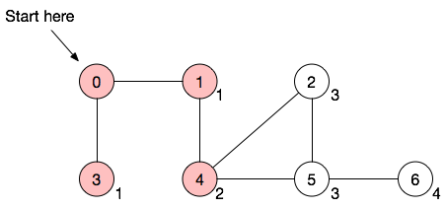
Example of BFS
Visit 3’s adjacent nodes add them to frontierQueue and discoveredSet.
Visit | 3
frontierQueue | 4
discoveredSet | 0,1,3,4

Slide 19
Example of BFS
Visit 4’s adjacent nodes add them to frontierQueue and discoveredSet.
Visit | 4
frontierQueue | 2,5
discoveredSet | 0,1,3,4,2,5

Slide 20
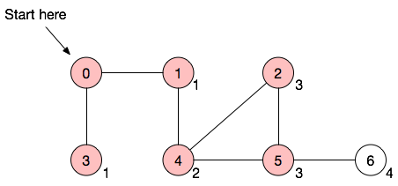
Example of BFS
Visit 2’s adjacent nodes add them to frontierQueue and discoveredSet.
Visit | 2
frontierQueue | 5
discoveredSet | 0,1,3,4,2,5

Slide 21
Example of BFS
Visit 5’s adjacent nodes add them to frontierQueue and discoveredSet.
Visit | 5
frontierQueue | 6
discoveredSet | 0,1,3,4,2,5,6

Slide 22
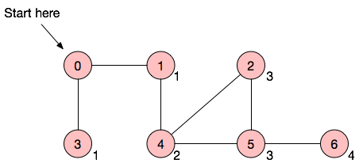
Example of BFS
Visit 6’s adjacent nodes add them to frontierQueue and discoveredSet.
Visit | 6
frontierQueue
discoveredSet | 0,1,3,4,2,5,6

Slide 23
C++ implementation
We need a few objects to help us:
frontierQueue is a Queue
discoveredSet is an IntegerSet
We can implement BFS as a class or as a function.

Slide 24
C++ function for BFS
void BreadthFirstSearch(Graph &graph, int start) {
IntegerSet discovered; Queue frontier;
frontier.push(start);
discovered.insert(start);
while(!frontier.empty()) {
int node = frontier.peek(); visit(node);
Graph::adjacency_iterator it = graph.getAdjacencyList(node);
while(!it.end()) {
int j = it.getItem();
if(!discovered.search(j)){ frontier.push(j); discovered.insert(j); }
it.increment();
}
frontier.pop();
}
}

Slide 25
C++ function for BFS
We can use this function directly on any Graph object.
But, if we want to customize the action we take when visiting the node, it’s cumbersome.

Slide 26
C++ BFS class
class BreadthFirstSearch {
protected:
Graph &g;
public:
BreadthFirstSearch(Graph &ag):g(ag){};
void run(int start); // same as function on prior slide
virtual void visit(int node){}// extend this class to customize visit
};
class PrintBFSOrder : public BreadthFirstSearch {
public:
void visit(int node) override { printf(“%d “); };
};

Slide 27
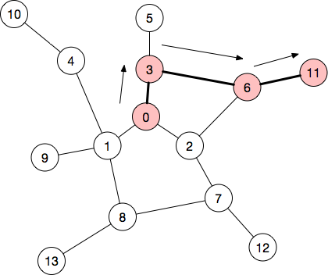
Depth-First Search
Follow a path until no new node can be reached...
(red nodes on current search path)

Slide 28
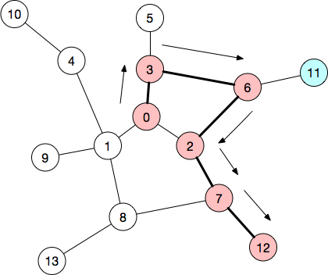
Depth-First Search
Follow a path until no new node can be reached...
then backtrack to a node with other paths and explore them.
(blue nodes are ones already visited)

Slide 29
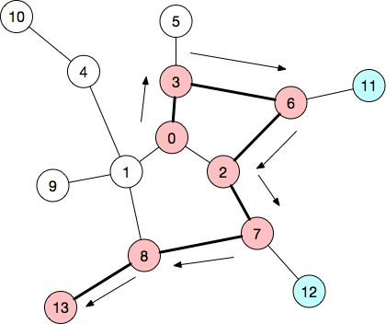
Depth-First Search
... we keep backtracking and finding new paths until we visit all possible nodes.
Backtrack to 7, follow path to 13.

Slide 30
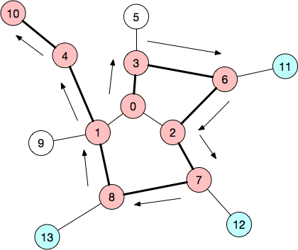
Depth-first Search
Backtrack to 8, and following path to 10.

Slide 31
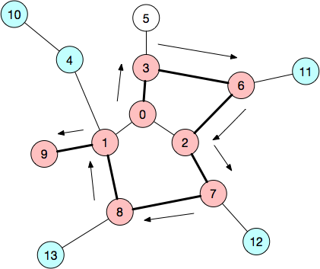
Depth-first Search
Backtrack to 1, and follow path to 9.

Slide 32
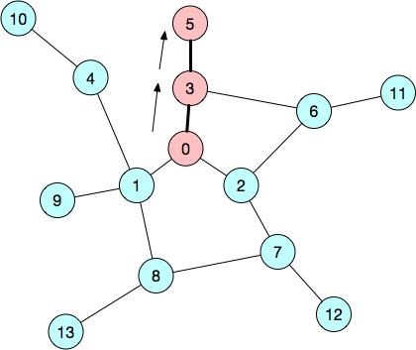
Depth-first Search
Backtrack to 3, and follow path to 5.

Slide 33
Depth-first search algorithm
To support backtracking, we use a stack.
Push nodes onto the stack as we find them.
Pop them off after all of their adjacent nodes have been visited
We can use a recursive function as our stack.
To prevent visiting a node twice, we need a set to track visited nodes.

Slide 34
Example
Calculate the DFS order for the following graph twice, once starting at node 6 and once at node 4.

Slide 35
Recursive depth-first search
RecursiveDFS(node) { if ( node is not in visitedSet ) { Add node to visitedSet; visit(node); for each vertex adjV adjacent to node { RecursiveDFS(adjV);
}
}
}

Slide 36
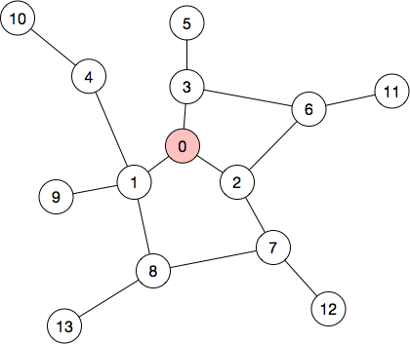
Example of recursive DFS
Visited: 0
Call Stack | Node | Adjacent Nodes
RecursiveDFS(0) | 0 | 3,2,1

Slide 37
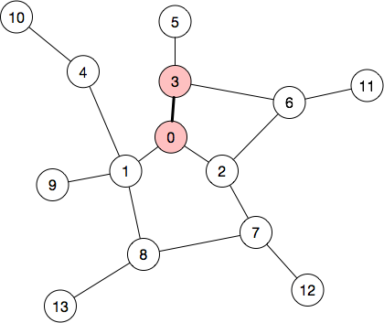
Example of recursive DFS
Visited: 0, 3
Call Stack | Node | Adjacent Nodes
RecursiveDFS(0) | 0 | 3,2,1
RecursiveDFS(3) | 3 | 5,6,2,0

Slide 38
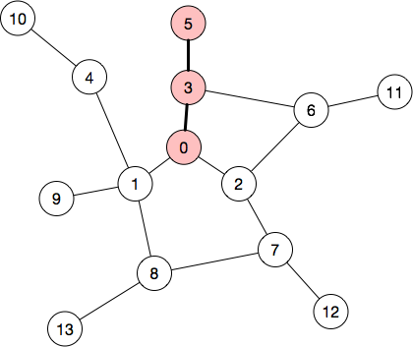
Example of recursive DFS
Visited: 0, 3, 5
Call Stack | Node | Adjacent Nodes
RecursiveDFS(0) | 0 | 3,2,1
RecursiveDFS(3) | 3 | 5,6,2,0
RecursiveDFS(5) | 5 | 3
5’s only adjacent node has already been visited.
The recursive base case is reached, so we return to Node 3 and consider it’s next adjacent node.

Slide 39
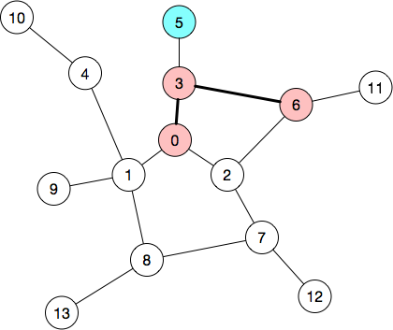
Example of recursive DFS
Visited: 0, 3, 5, 6
Call Stack | Node | Adjacent Nodes
RecursiveDFS(0) | 0 | 3,2,1
RecursiveDFS(3) | 3 | 6,2,0
RecursiveDFS(6) | 6 | 3,11,2
The first adjacent node for 6 is 3. But, 3 has already been visited. So, we skip it.

Slide 40
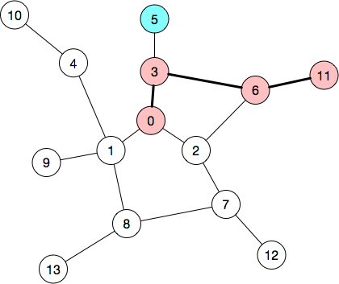
Example of recursive DFS
Visited: 0, 3, 5, 6, 11
Call Stack | Node | Adjacent Nodes
RecursiveDFS(0) | 0 | 3,2,1
RecursiveDFS(3) | 3 | 6,2,0
RecursiveDFS(6) | 6 | 11,2
RecursiveDFS(11) | 11 | 6
11 has one adjacent node, 6, but it has already been visited. So, RecursiveDFS(11) is done.

Slide 41
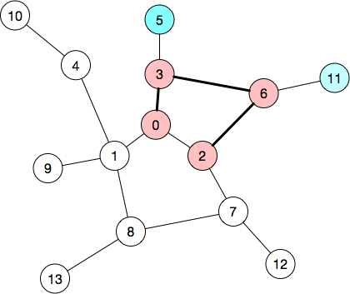
Example of recursive DFS
Visited: 0, 3, 5, 6, 11, 2
Call Stack | Node | Adjacent Nodes
RecursiveDFS(0) | 0 | 3,2,1
RecursiveDFS(3) | 3 | 6,2,0
RecursiveDFS(6) | 6 | 11,2
RecursiveDFS(2) | 2 | 7,6,0

Slide 42
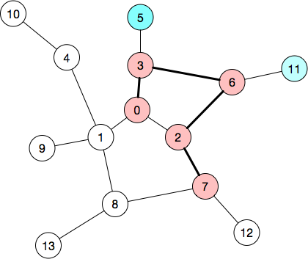
Example of recursive DFS
Visited: 0, 3, 5, 6, 11, 2, 7
Call Stack | Node | Adjacent Nodes
RecursiveDFS(0) | 0 | 3,2,1
RecursiveDFS(3) | 3 | 6,2,0
RecursiveDFS(6) | 6 | 11,2
RecursiveDFS(2) | 2 | 7,6,0
RecursiveDFS(7) | 7 | 12,2,8

Slide 43
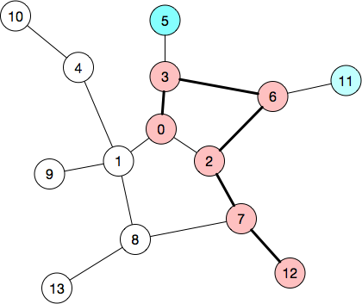
Example of recursive DFS
Call Stack | Node | Adjacent Nodes
RecursiveDFS(0) | 0 | 3,2,1
RecursiveDFS(3) | 3 | 6,2,0
RecursiveDFS(6) | 6 | 11,2
RecursiveDFS(2) | 2 | 7,6,0
RecursiveDFS(7) | 7 | 12,2,8
RecursiveDFS(12) | 12 | 7
Visited: 0, 3, 5, 6, 11, 2, 7, 12
12 has one adjacent node, 7, but it has already been visited. So, RecursiveDFS(12) is done.

Slide 44
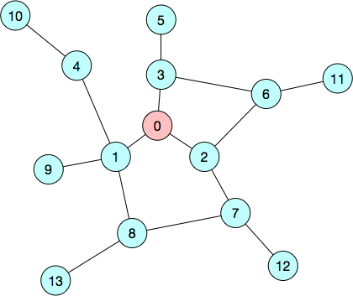
Skipping ahead...
Call Stack | Node | Adjacent Nodes
RecursiveDFS(0) | 0 | 2,1
Visited: 0, 3, 5, 6, 11, 2, 7, 12, 8, 13, 1, 4, 10, 9
RecursiveDFS would continue until all new nodes found were already visited.
This will occur once we return to RecursiveDFS(0) and discover that 2 and 1 have already been visited.
Then the algorithm ends.

Slide 45
C++ recursive function implementation
void DepthFirstSearch(Graph &g, IntegerSet &visitedSet, int node){ if ( !visitedSet.search(node) ) {
visit(node); // take action upon visit to node visitedSet.insert(node); for (Graph::adjacency_iterator it=g.getAdjList(node); !it.end();
it.increment()) DepthFirstSearch(g,visitedSet,it.getItem());
}
}
}

Slide 46
C++ DFS class
class DepthFirstSearch {
protected:
Graph &g;
void dfs_helper(int node, IntegerSet &visited);// same as prior slide
public:
DepthFirstSearch(Graph &ag):g(ag){};
void run(int start);
virtual void visit(int node){}// extend this class to customize visit
};
class PrintDFSOrder : public DepthFirstSearch {
public:
void visit(int node) override { printf(“%d “); };
};

Slide 47
Summary
DFS and BFS are common approaches for performing a graph traversal.
Both BFS and DFS begin at a specific start node.
BFS visits nodes successively further away from the start node.
DFS goes as far away as possible, then backtracks to discover other nodes and paths.
We can implement DFS or BFS as a function or class; a class makes it possible to override a visit function to customize the traversal.

Slide 48
References
1. ZyBook on Data Structures, chapter 19.5 and 19.6

Slide 49
Backup slides

Slide 50
Depth-first search algorithm (Z6.5.1)
DFS(startV){ push startV to stack; while ( stack is not empty ) { currentV = pop from stack; if ( currentV is not in visitedSet ) {
visit(currentV); add currentV to visitedSet; for (each vertex adjV adjacent to currentV) Push adjV to stack;
}
}
}

Slide 51
C++ implementation (Z6.5.1)
void DepthFirstSearch(Graph &g, int startV){ IntegerSet visitedSet;
Stack stack;
stack.push(startV); while ( !stack.empty() ) { currentV = stack.peek(); stack.pop(); if ( !visitedSet.find(currentV) ) {
visit(currentV); visitedSet.insert(currentV); for (Graph::adjacency_iterator it=g.getAdjList(startV); !it.end(); it.increment()) stack.push(it.getItem());
}
}
}

